Slide 1
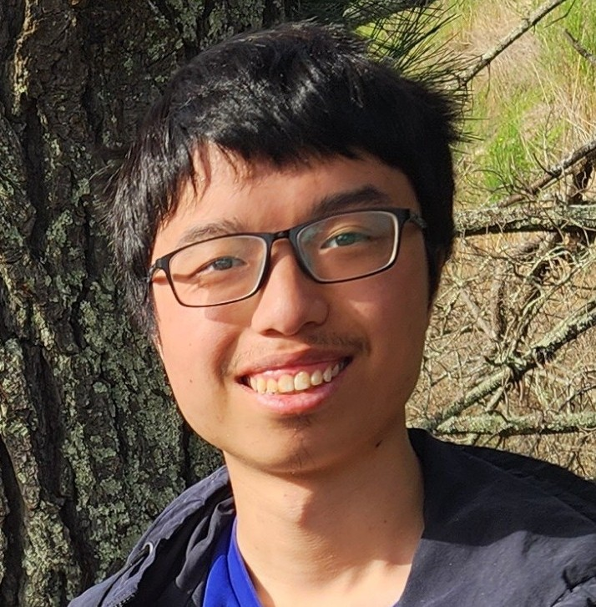


Online Steiner Forest with Recourse
Yaowei Long
U Michigan, MSR intern
Sepideh Mahabadi
MSR
Sherry Sarkar
CMU, MSR intern
Jakub Tarnawski
MSR
09.07.2026 ICALP

Slide 2

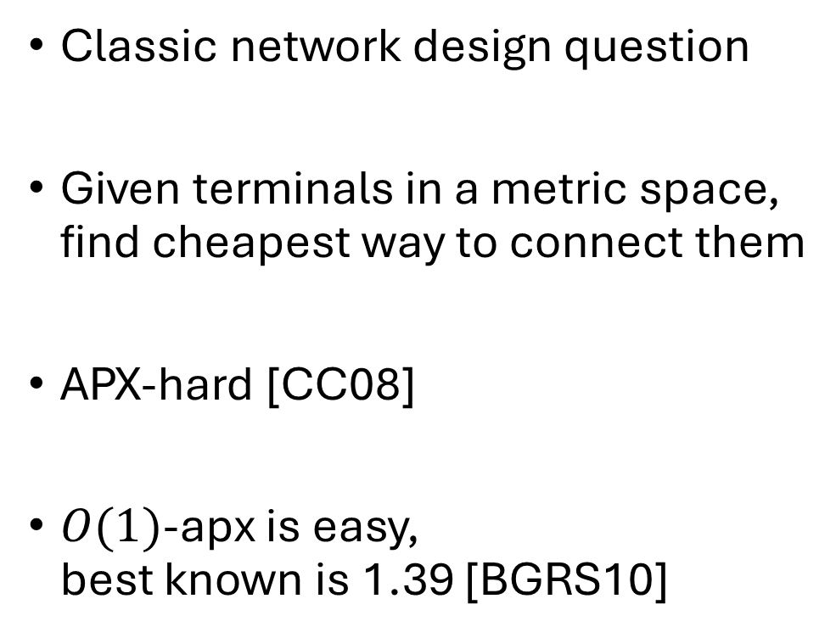


Steiner Tree problem
Classic network design question
Given terminals in a metric space,
find cheapest way to connect them
APX-hard [CC08]
$O(1)$-apx is easy,
best known is 1.39 [BGRS10]

Slide 3
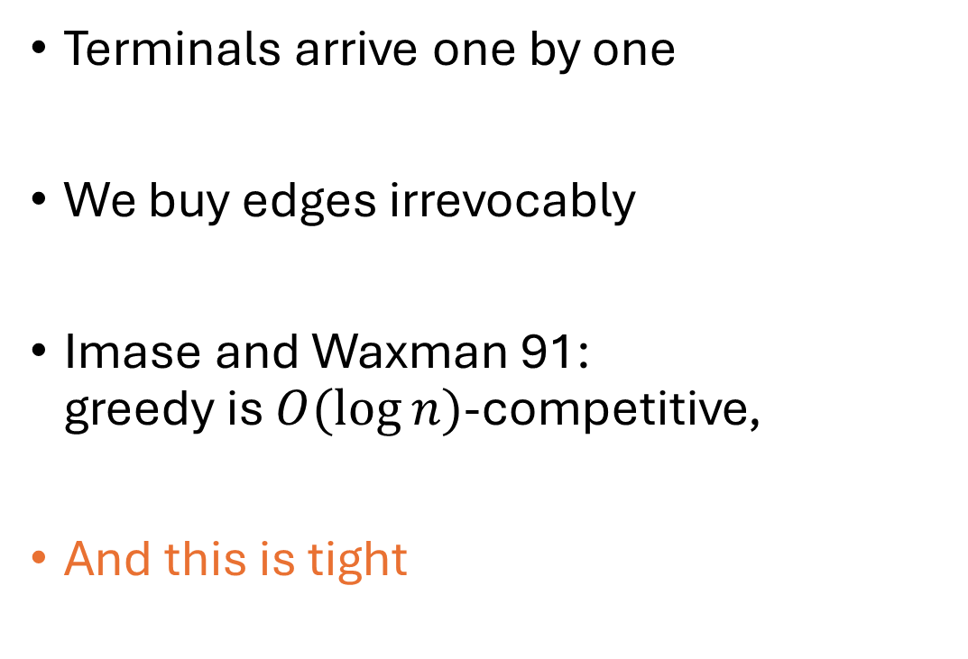

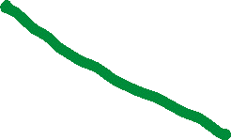
Online Steiner Tree
Terminals arrive one by one
We buy edges irrevocably
Imase and Waxman 91:
greedy is $O(\log{n)}$-competitive,
And this is tight

Slide 4
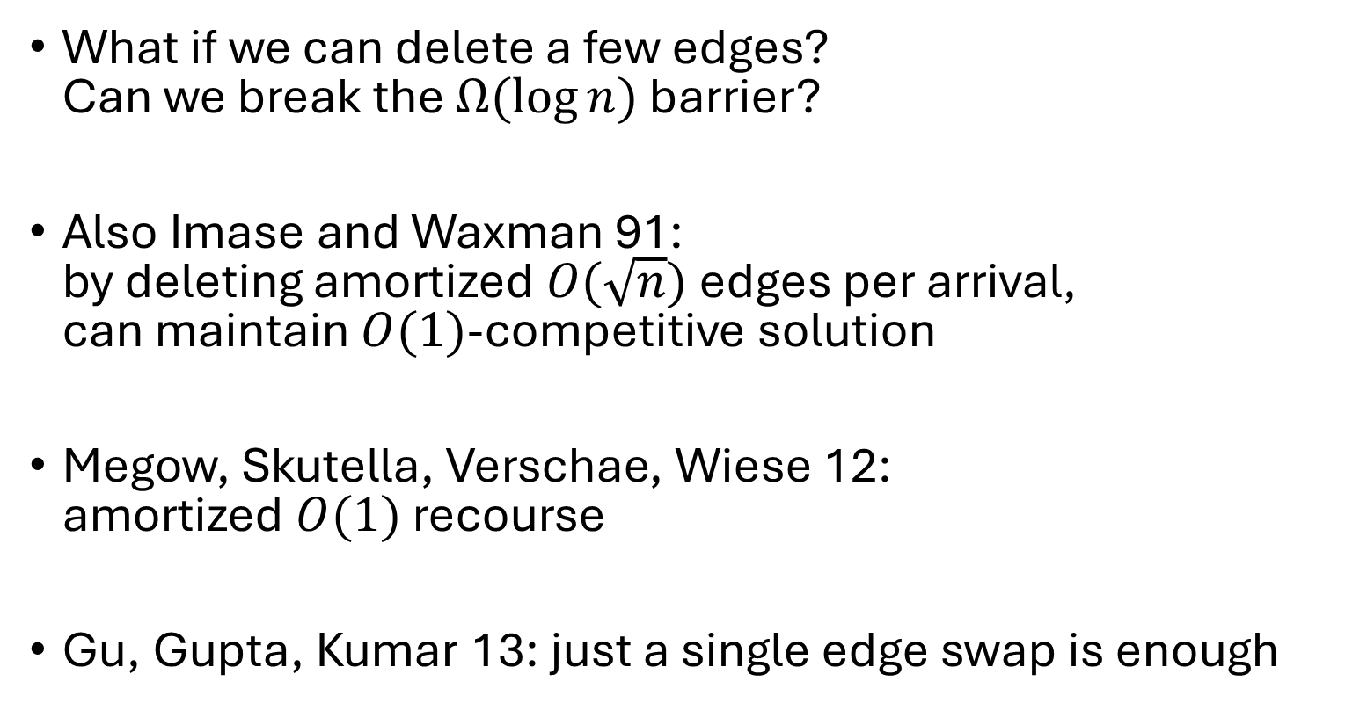

Online Steiner Tree with recourse
active area of research
What if we can delete a few edges?
Can we break the $Ω(\log{n)}$ barrier?
Also Imase and Waxman 91:
by deleting amortized $O(\sqrt{n})$ edges per arrival,
can maintain $O(1)$-competitive solution
Megow, Skutella, Verschae, Wiese 12:
amortized $O(1)$ recourse
Gu, Gupta, Kumar 13: just a single edge swap is enough
Notes:
Can we

Slide 5




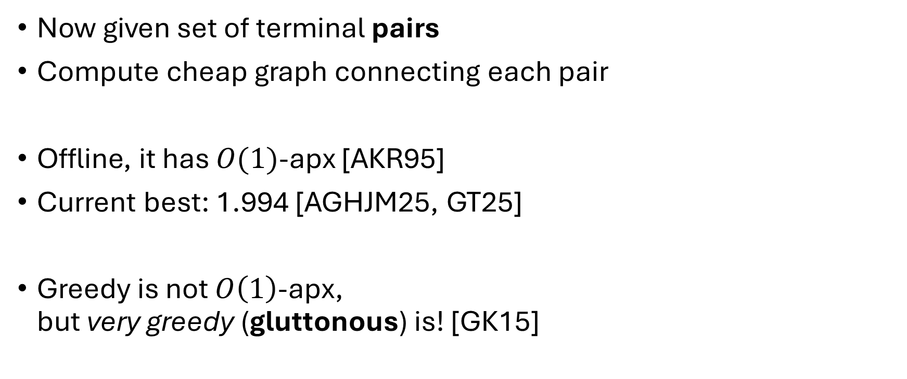






Steiner Forest
$$s_{1}$$
$$s_{2}$$
$$s_{3}$$
Now given set of terminal pairs
Compute cheap graph connecting each pair
Offline, it has $O(1)$-apx [AKR95]
Current best: 1.994 [AGHJM25, GT25]
Greedy is not $O\left(1\right)$-apx,
but very greedy (gluttonous) is! [GK15]
$$t_{3}$$
$$t_{1}$$
$$t_{2}$$

Slide 6



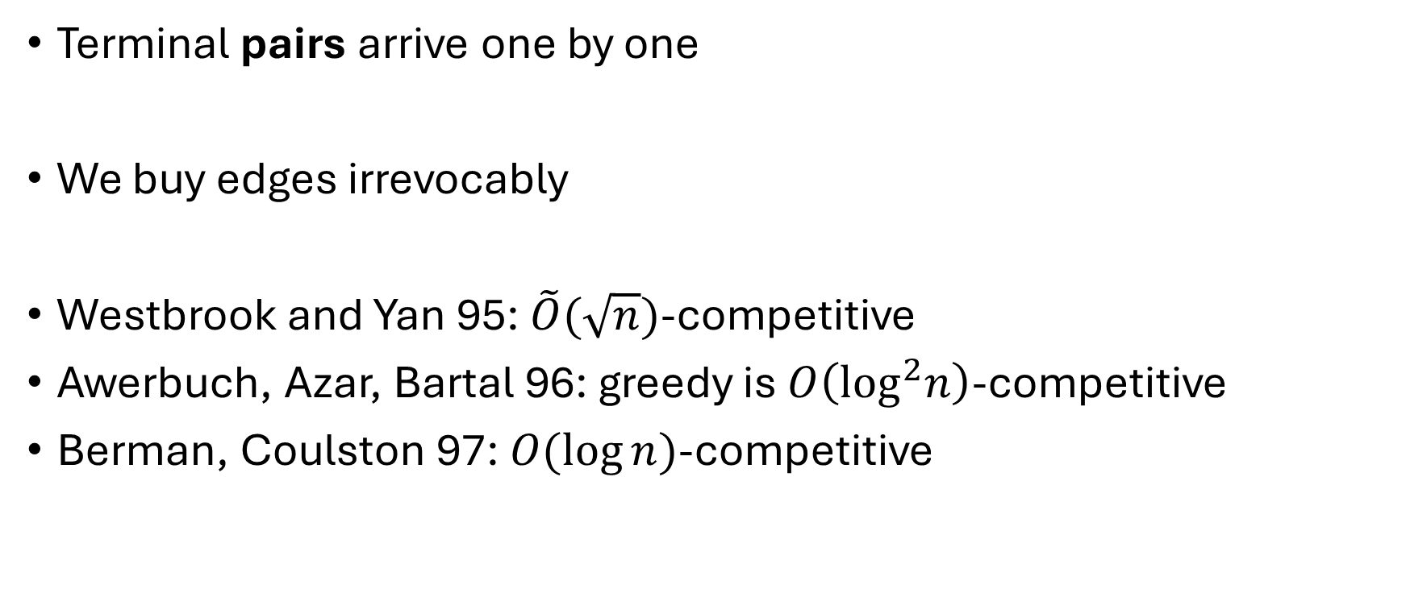









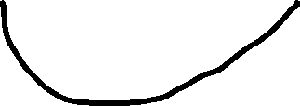



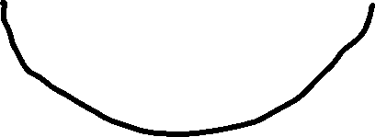



Online Steiner Forest
Terminal pairs arrive one by one
We buy edges irrevocably
Westbrook and Yan 95: $\tilde{O}(\sqrt{n})$-competitive
Awerbuch, Azar, Bartal 96: greedy is $O\left(\log^{2}n\right)$-competitive
Berman, Coulston 97: $O(\log{n)}$-competitive
$$s_{1}$$
$$s_{2}$$
$$s_{3}$$
$$t_{3}$$
$$t_{2}$$
$$t_{1}$$
Tight (already for Steiner tree)
Not greedy
(comp ratio of greedy is open)

Slide 7
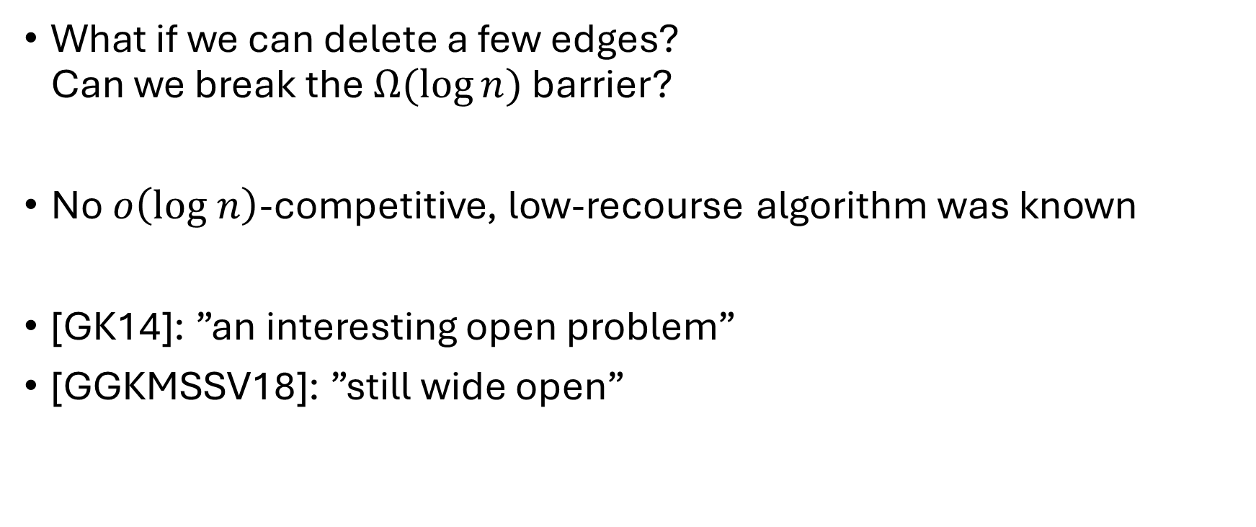
Online Steiner Forest with recourse
What if we can delete a few edges?
Can we break the $Ω(\log{n)}$ barrier?
No $o\left(log n\right)$-competitive, low-recourse algorithm was known
[GK14]: ”an interesting open problem”
[GGKMSSV18]: ”still wide open”

Slide 8


Online Steiner Forest with recourse
Also tradeoff: for $λ∈[1,\log{n}]$,
we can maintain $O(λ)$-competitive solution with $O\left(\frac{\log{n}}{λ}\right)$ recourse
Our result:
algorithm for online Steiner Forest
that maintains an $O(1)$-competitive solution
with $O(\log{n)}$ amortized recourse

Slide 9

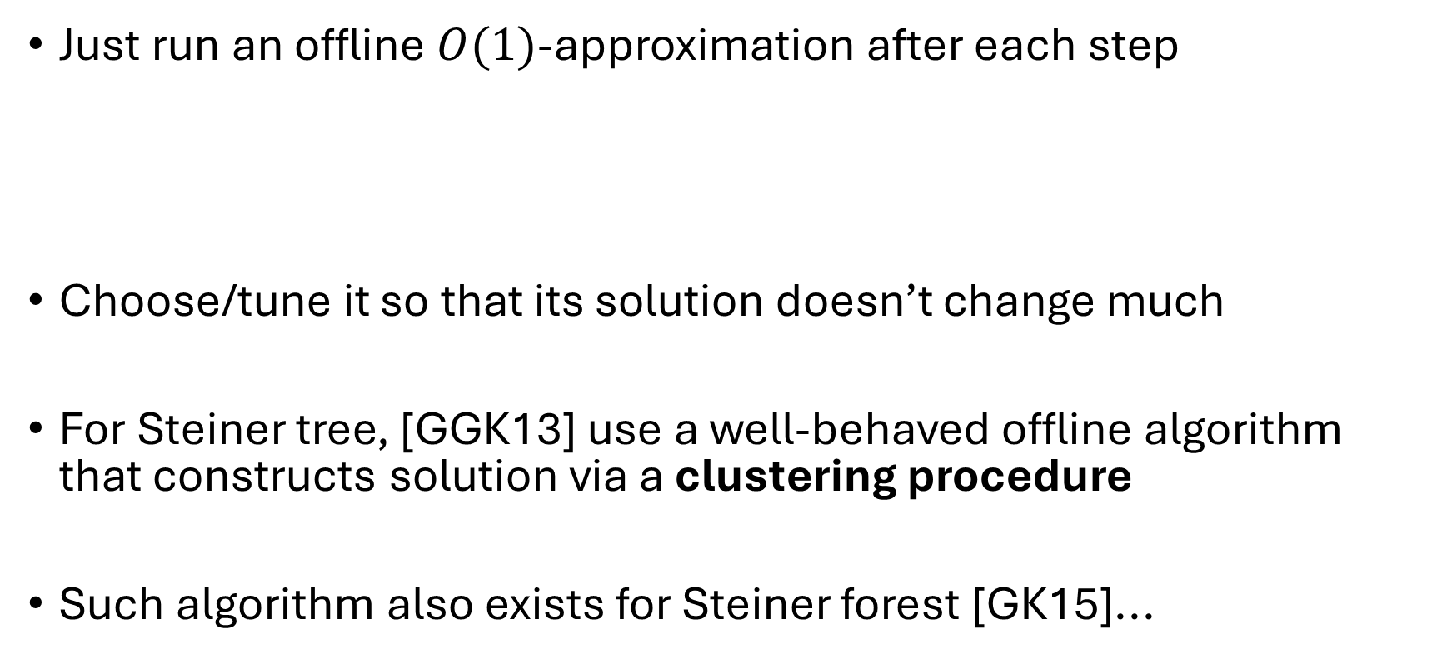
General recipe
Just run an offline $O(1)$-approximation after each step
Choose/tune it so that its solution doesn’t change much
For Steiner tree, [GGK13] use a well-behaved offline algorithm
that constructs solution via a clustering procedure
Such algorithm also exists for Steiner forest [GK15]...
For free: competitive ratio $O(1)$
TODO: bound the recourse

Slide 10

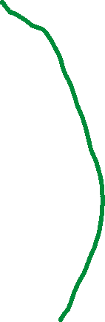
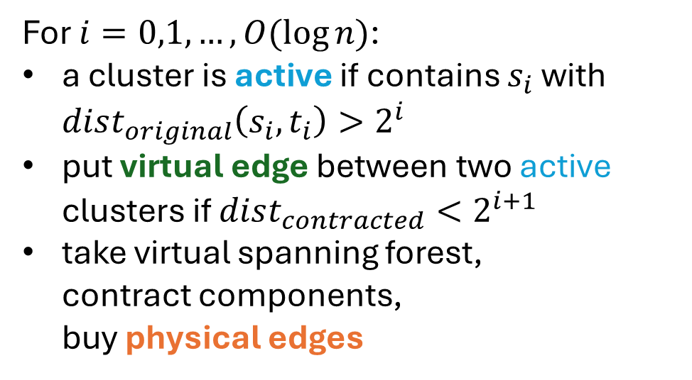
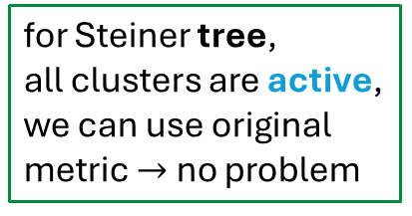



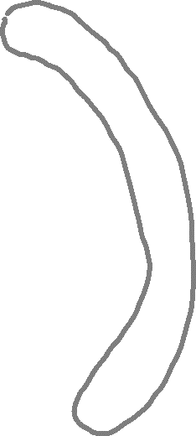








Timed gluttonous algorithm for Steiner forest [GK15]
For $i=0,1,…,O(\log{n)}$:
a cluster is active if contains $s_{i}$ with $dist_{original}\left(s_{i},t_{i}\right)>2^{i}$
put virtual edge between two active clusters if $dist_{contracted}<2^{i+1}$
take virtual spanning forest,
contract components,
buy physical edges
$$s_{4}$$
$$s_{1}$$
$$t_{1}$$
$$s_{2}$$
for Steiner tree,
all clusters are active, we can use original metric $→$ no problem
$$t_{2}$$
$$s_{3}$$
$$t_{3}$$
Issue: many physical edges added,
and would need to be removed to reverse this merge
$$t_{4}$$

Slide 11

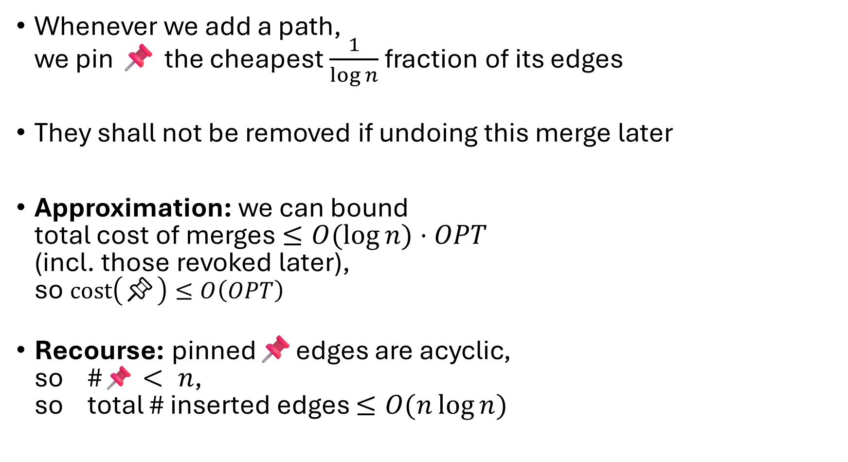

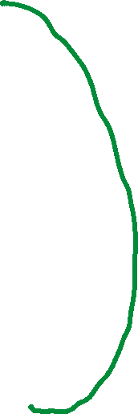
Key idea: 📌ing edges
Whenever we add a path,
we pin 📌 the cheapest $\frac{1}{\log{n}}$ fraction of its edges
They shall not be removed if undoing this merge later
Approximation: we can bound
total cost of merges $≤O(\log{n)⋅OPT}$
(incl. those revoked later),
so $cost\left(\text{📌}\right)≤O\left(OPT\right)$
Recourse: pinned📌edges are acyclic,
so #📌$< n$,
so total # inserted edges $≤O(n\log{n)}$
📌
📌

Slide 12


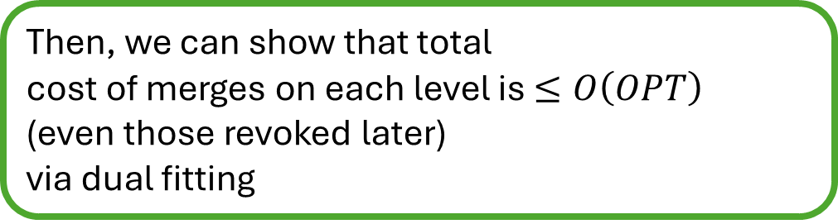
Second idea: inherit virtual edges
For $i=0,1,…,O(\log{n)}$:
a cluster is active if contains $s_{i}$ with $dist_{original}\left(s_{i},t_{i}\right)>2^{i}$
put virtual edge between two active clusters if $dist_{contracted}<2^{i+1}$
take virtual spanning forest,
contract components,
buy physical edges
Try as much as possible
to reuse inherited edges
(those that were used
for previous timestep’s solution)
Then, we can show that total
cost of merges on each level is $≤O\left(OPT\right)$
(even those revoked later)
via dual fitting

Slide 13

Our result:
algorithm for online Steiner Forest
that maintains an $O(1)$-competitive solution
with $O(\log{n)}$ amortized recourse

Slide 14
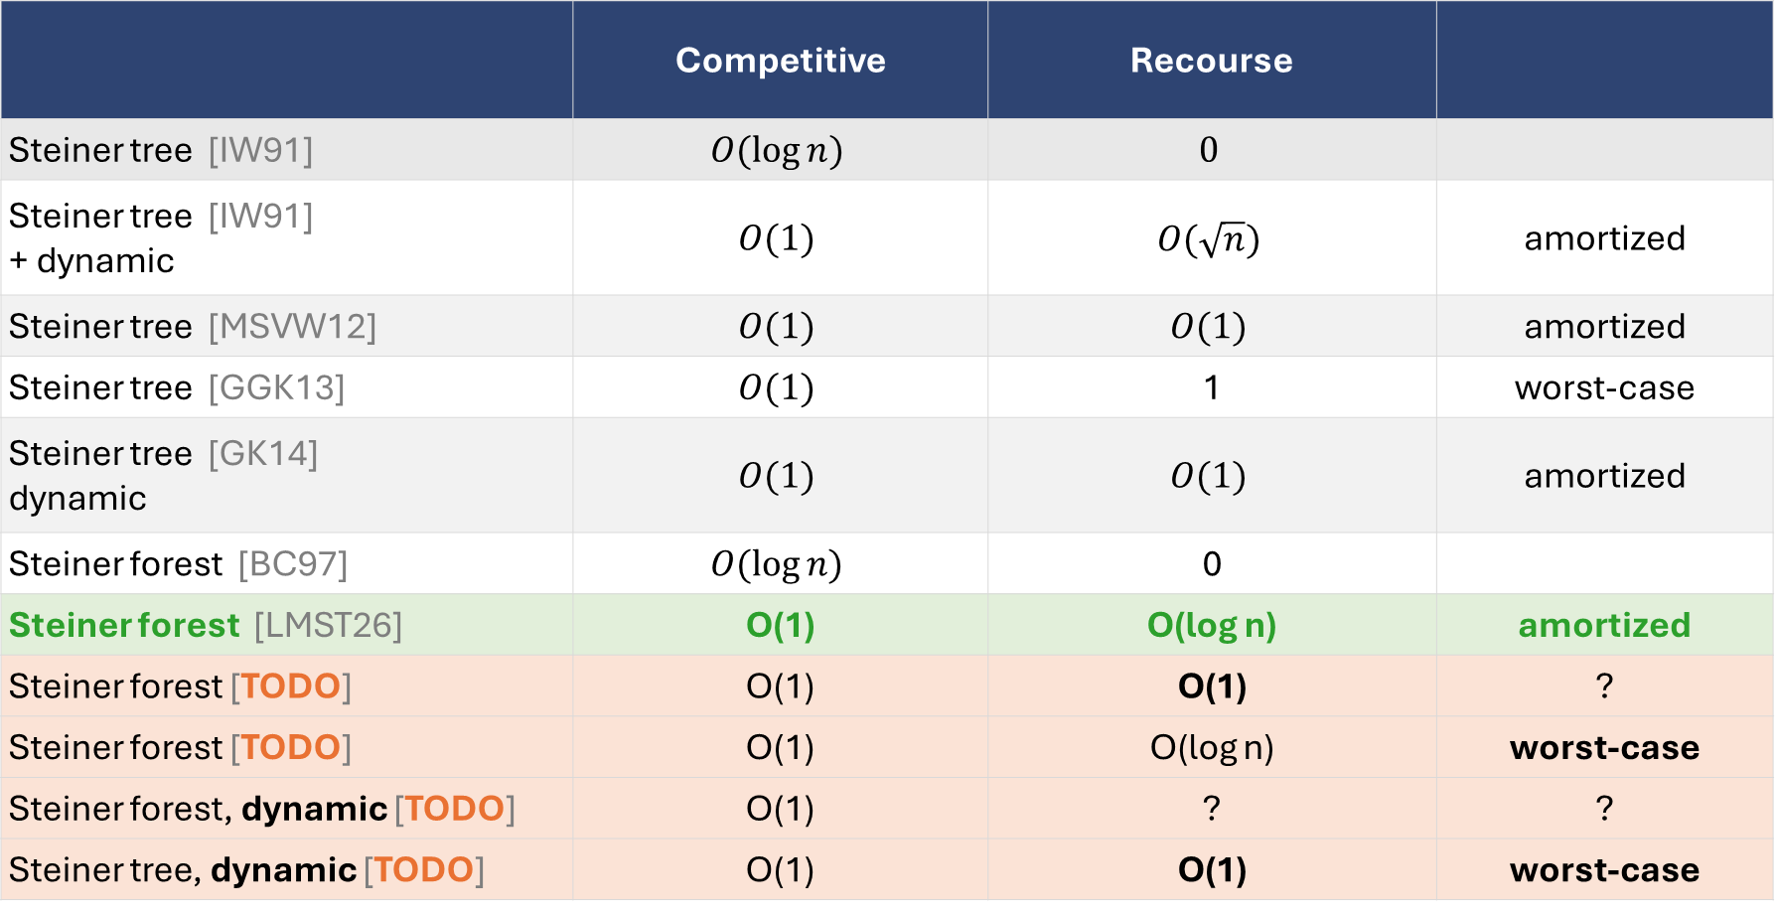
Prior and future work
📌
📌
Thank you!
 | Competitive | Recourse
Steiner tree [IW91] | $$O(\log{n})$$ | $$0$$
Steiner tree [IW91] + dynamic | $$O(1)$$ | $$O(\sqrt{n})$$ | amortized
Steiner tree [MSVW12] | $$O(1)$$ | $$O(1)$$ | amortized
Steiner tree [GGK13] | $$O(1)$$ | 1 | worst-case
Steiner tree [GK14] dynamic | $$O(1)$$ | $$O(1)$$ | amortized
Steiner forest [BC97] | $$O(log⁡n)$$ | 0
Steiner forest [LMST26] | O(1) | O(log n) | amortized
Steiner forest [TODO] | O(1) | O(1) | ?
Steiner forest [TODO] | O(1) | O(log n) | worst-case
Steiner forest, dynamic [TODO] | O(1) | ? | ?
Steiner tree, dynamic [TODO] | O(1) | O(1) | worst-case

